Slide 1

Fixed-point Iteration
Prianka Mandal
Lecturer
Daffodil International University

Slide 2
Introduction
Open methods employ a formula to predict the root
Such a formula can be developed for simple fixed-point iteration by rearranging the function f(x) = 0, so that x is on the left-hand side of the equation:
x = g(x)
It is also called, one-point iteration or successive substitution

Slide 3
How does it work?
The transformation can be accomplished either by algebraic manipulation or by simply adding x to both sides of the original equation.
For example,
x² − 2x + 3 = 0
can be simply manipulated to yield
x = (x² + 3) / 2
Again,
sin x = 0
by adding x to both sides to yield
x = sin x + x

Slide 4
Formula for Fixed-Point Iteration
The main idea is to provide a formula to predict a new value of x as a function of an old value of x.
Thus, given an initial guess at the root x_{i}, an equation can be used to compute a new estimate x_{i+1} as expressed by the iterative formula,
x_{i+1} = g(x_{i})

Slide 5
Example
Convert the given equation in the form x = g(x) Examples:
x² – 1 = 0 can be written as
x = 1 / x
or
x = x² + x –1
x² + x – 2 = 0 can be written as
x = 2 – x²
x = sqrt(2 – x)

Slide 6
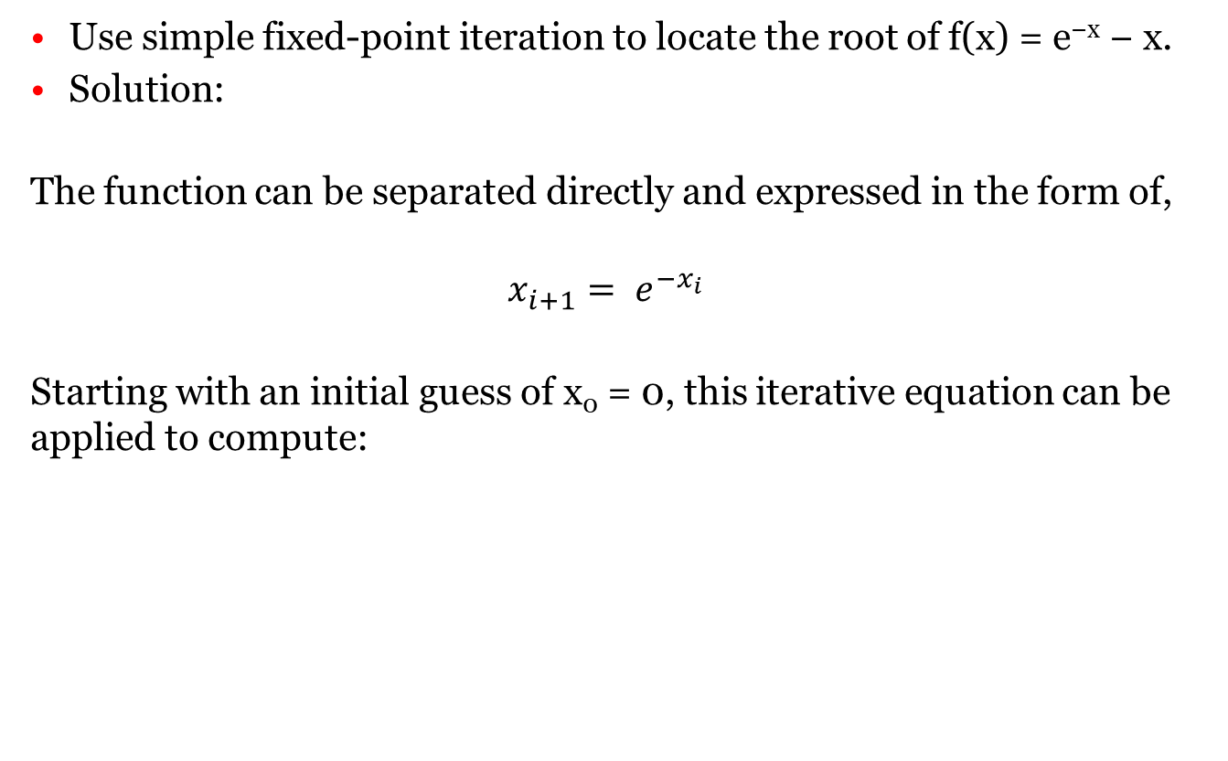
Problem Statement
Use simple fixed-point iteration to locate the root of f(x) = e^{−x} − x.
Solution:
The function can be separated directly and expressed in the form of,
$$x_{i+1}= e^{−x_{i}}$$
Starting with an initial guess of x₀ = 0, this iterative equation can be applied to compute:

Slide 7
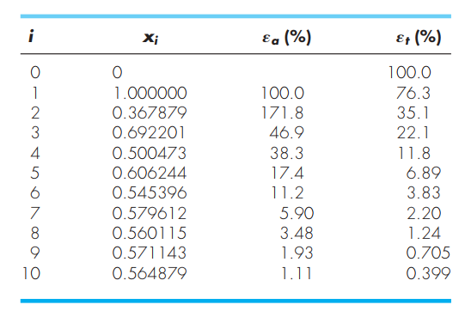
Example
Thus, each iteration brings the estimate closer to the true value of the root: 0.56714329.

Slide 8
Type of divergence
Oscillatory divergence
Monotone divergence

Slide 9
Thank you!!!

